Slide 1

Helping Hands
Food wastage Management System
SUBMITTED BY,
ATHIRA SAJEEV

Slide 2
CONTENTS
ABSTRACT
MODULE DESCRIPTION
ABOUT
EXISTING SYSTEM
PROPOSED SYSTEM
SYSTEM SPECIFICATION
TABLE DESIGN
UML DIAGRAM
SEQUENCE DIAGRAM
FORMS

Slide 3
Abstract
This project is used to manage wastage foods in a useful way.
Every day the people are wasting lots of foods. So we have to reduce that food wastage problem through online.
If a user wishes to donate something, he/she can send a message in application. This message will be shown as notification in donations tab to other users.
This message will be stored in backend in the database.
Once a notification is sent, the orphanages who wish to claim the donations can reply to the donor and contact him/her.
The reciever can also perform operations like requesting for items, viewing requested items and claiming donations.

Slide 4
After accepting the notification, the organization will contact with the guest and then confirms the order.
Users can also choose any organization and treat them during any occations like birthday,anniversary celebrations,etc.
An Agent module is there in this project.Here, different agencies can register in the system and they can act as a third party to donate things to poor people.The registered agency is approved by the admin.
This project is food redistribution is an enormously successful social innovation that tackles food waste and food poverty. The user’s details are maintained confidential because it maintains a separate account for each user.

Slide 5
Module description
1. Admin
Admin has a login to the system. Admin will manage the sponsors registration, organization registration and providing informations to them.
2. Sponsor
Sponsor is a common user. He can register in this system and get a login. He/she just need to put the amount of food available and location then system will notifies the nearby organization.
3. NGO
NGO will help the sponsors to select the nearby organization. They can book the sponsor order and collect the food.
Agency
Agency has a login into the system.Admin will approve the agency.Approved agency can login into the system and they can view the requests and accept it .

Slide 6
About
My topic is “HelpingHands”,It’s a Food Wastage Management system. The purpose of this software application is it can be used to manage wastage foods in a useful way.Food redistribution is an enormously successful social innovation that tackles food waste and food poverty.
I am doing my project in ASP.NET. Building tools are :
Microsoft Visual Studio
Microsoft SQL Server
GITHub

Slide 7
EXISTING SYSTEM
Currently, people donate stuff manually by visiting each organization number of times.
In existing system if anyone have extra food because of any function or in their home it will be become waste because instantly there is no way to share with anyone if they are having lots of food.
Even if they want to give that extra food to any orphanage or poor people they don’t have time or don’t have an idea about that
So that we have create a application for sponsor that extra food to poor people or nearby orphanage.

Slide 8
PROPOSED SYSTEM
In proposed system we are reduce that food wastage using that application.
This project is food redistribution is an enormously successful social innovation that tackles food waste and food poverty.
The donator can create the account and whenever they are having wastage food they can login and give details and send a notification.
Once a notification is sent, the orphanages who wish to claim the donations can reply to the donor and contact him/her.
The reciever can also perform operations like requesting for items, viewing requested items and claiming donations
After accepting the notification, the organization will contact with the guest and then confirms the order.
An Agent module is there in this project.Here, different agencies can register in the system and they can act as a third party to donate things to poor people.The registered agency is approved by the admin.

Slide 9
SYSTEM SPECIFICATION
Introduction to ASP.NET
ASP.NET is a web application framework developed and marketed by Microsoft to allow programmers to build dynamic web sites.
It allows you to use a full featured programming language such as C# or VB.NET to build web applications easily.
ASP.NET is a web development platform, which provides a programming model, a comprehensive software infrastructure and various services required to build up robust web applications for PC, as well as mobile devices.

Slide 10
Introduction to SQL Server 2008
MS SQL Server is database management software, which is rich and powerful application.
It is a language that enables us to create and operate on relational databases, which are sets of related information stored in tables. Because of its elegance and independence from machine specifies, as well as its support by the industry leaders in relational database technology, SQL become the standard language and will remain as it for the foreseeable future

Slide 11
TABLE DESIGN
Table no :1
Table name: tbl_admin
Id: Auto increment
Field | type | description
admin_id | Int | Id for admin
username | Varchar(50) | userame of admin
password | Varchar(50) | Password of admin

Slide 12
Table number : 2 table name: tbl_donor_reg donor_id: auto_increment
Field | type | description
donor_id | int | Donor Id
Donor_name | Varchar(50) | Donor Name
address | Varchar(50) | Adress
district | Varchar(50) | District
state | Varchar(50) | State
location | Varchar(50) | Location
email_id | Varchar(50) | Email ID
contact | Varchar(50) | Contact
username | Varchar(50) | Username
Password | Varchar(50) | Password
user_type | Varchar(50) | User Type

Slide 13
Table number :3 table name : tbl_reciever_reg reciever_id: foriegn key
field | type | descrption
reciever_id | int | Reciever id
user_type | Varchar(50) | User Type
address | Varchar(50) | Address
email_id | Varchar(50) | Email ID
Contact | Varchar(50) | Contact
location | Varchar(50) | Location
state_id | Varchar(50) | State
district_id | Varchar(50) | District
username | Varchar(50) | Username
password | Varchar(50) | Password
type_id | Varchar(50) | Type_id

Slide 14
Table number :4 table name : tbl_agent agent_id: foriegn key
field | type | descrption
agent_id | int | Agent id
agency_name | Varchar(50) | Agency Name
address | Varchar(50) | Address
email_id | Varchar(50) | Email ID
Contact | Varchar(50) | Contact
location | Varchar(50) | Location
state | Varchar(50) | State
district | Varchar(50) | District
username | Varchar(50) | Username
password | Varchar(50) | Password
type_id | Varchar(50) | Type_id
name_rep | Varchar(5) | Name of representative

Slide 15
Table number : 5 table name:tbl_sponsor
field | type | description
Sponsor_id | int | sponsor_id
location | Varchar(50) | Location
state | Varchar(50) | State
district | Varchar(50) | District
type | Varchar(50) | Type of NGO
name_org | Varchar(50) | Name of NGO
date_of_event | Varchar(50) | Date
quantity_food | Varchar(50) | Quantity

Slide 16
Table number : 6 table name:tbl_donor
filed | type | description
donor_id | int | Id of donor
donor_name | Varchar(50) | Donor name
Address | Varchar(50) | Address
location | Varchar(50) | Location
email_id | Varchar(50) | Email id
date_of_recieve | Varchar(50) | Date
contact | Varchar(50) | Contact
product_type | Varchar(50) | Type
item_name | Varchar(50) | Item
quantity | Varchar(50) | Quantity

Slide 17
Table number : 7 table name:tbl_notification
filed | type | description
notification_id | int | Notification Id
notification | Varchar(50) | Notification
donor_name | Varchar(50) | Donor_name
address | Varchar(50) | Address
email_id | Varchar(50) | Email ID
contact | Varchar(50) | contact

Slide 18
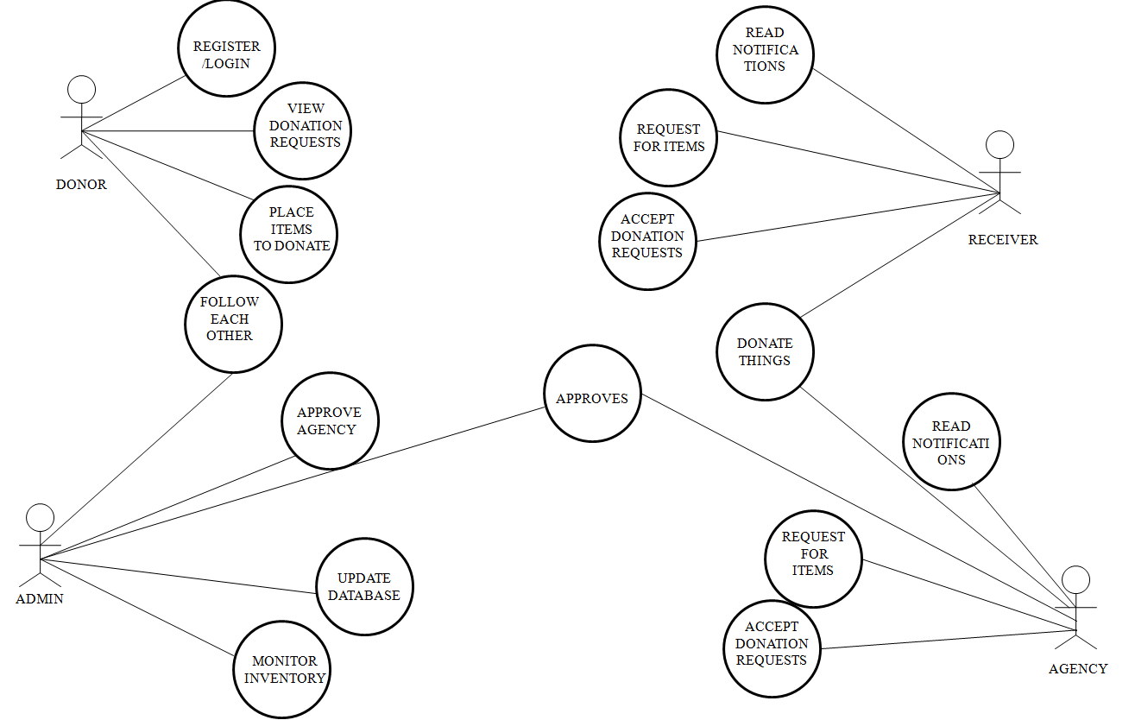
UML Diagram

Slide 19
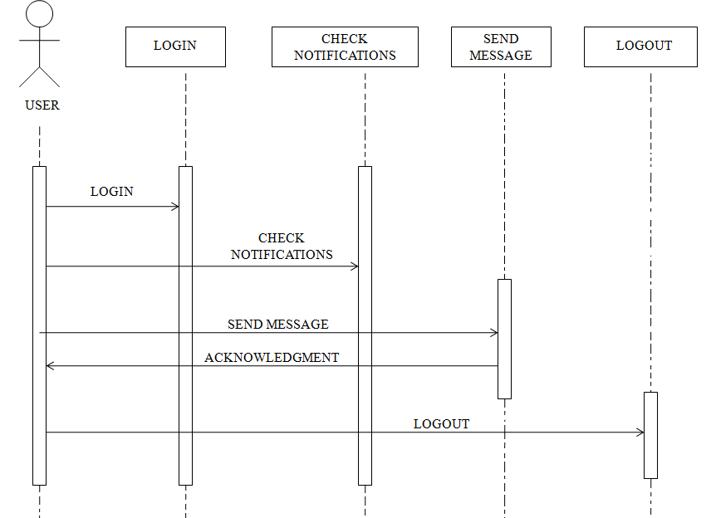
Sequence diagram

Slide 20
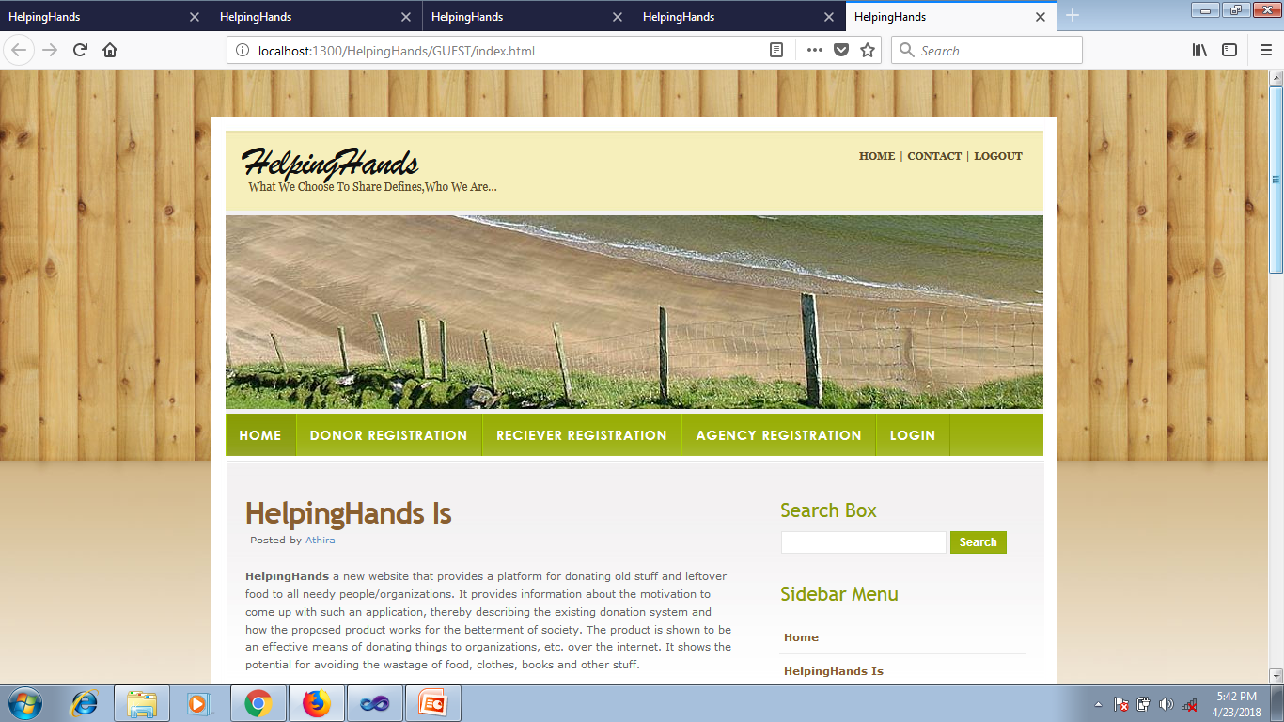
FORMS Guest Home Page

Slide 21
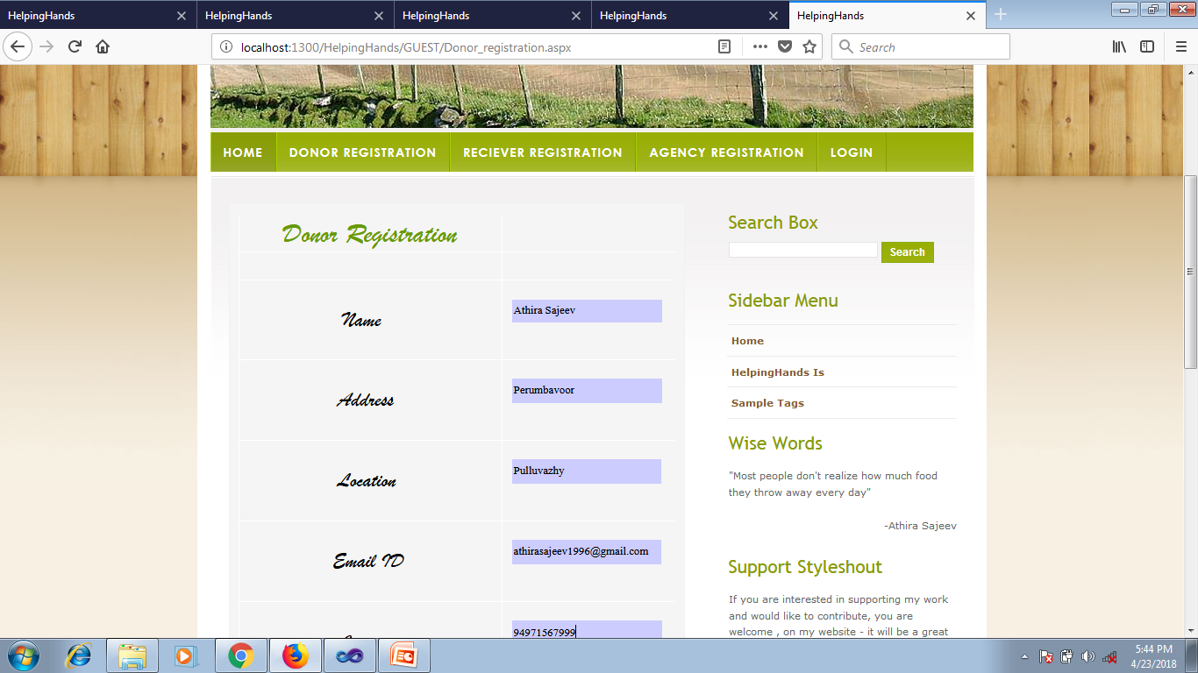

Slide 22
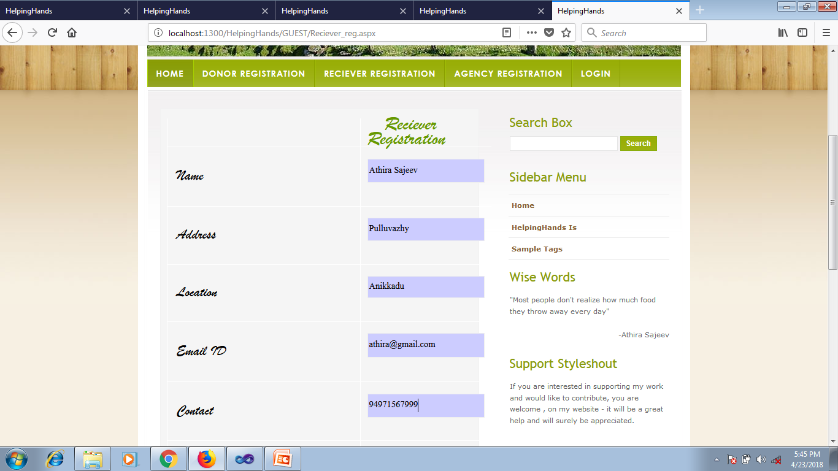

Slide 23
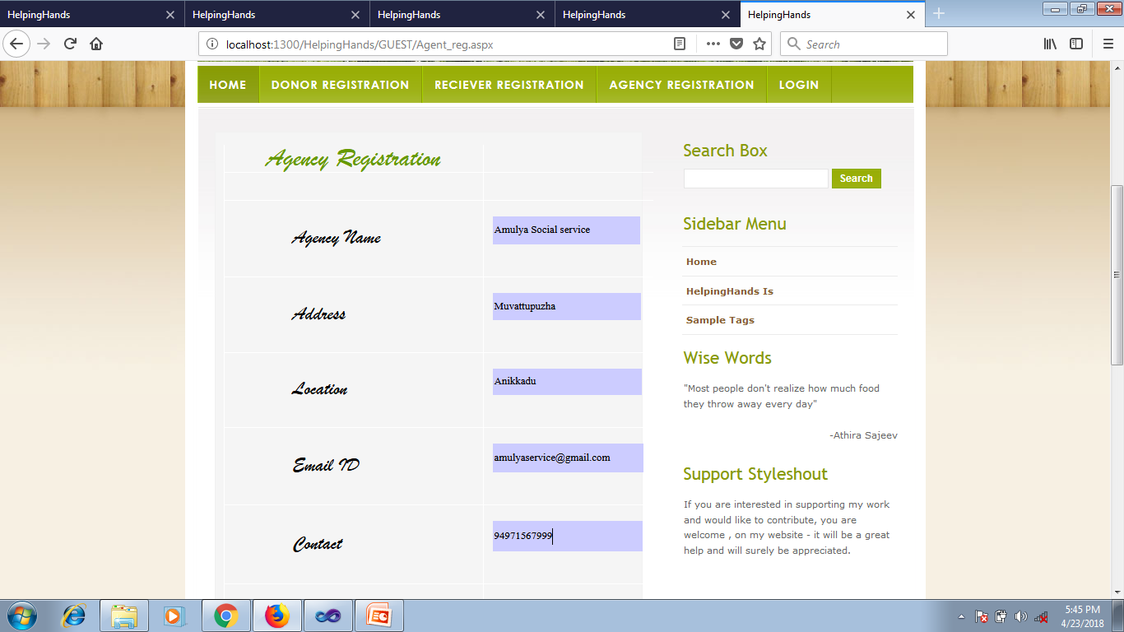

Slide 24
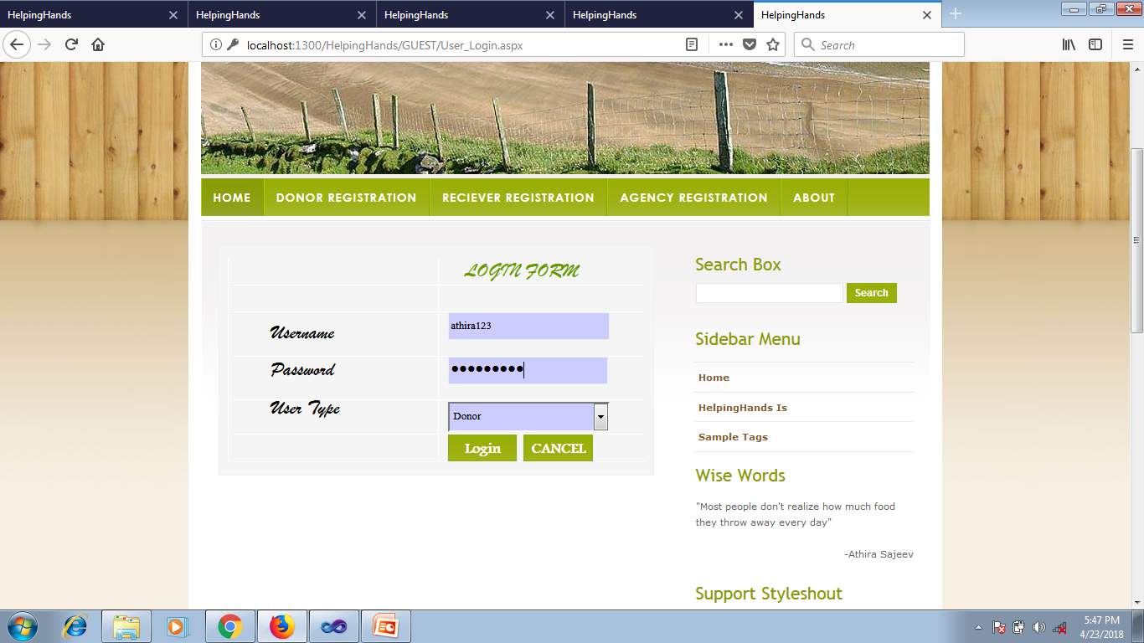

Slide 25
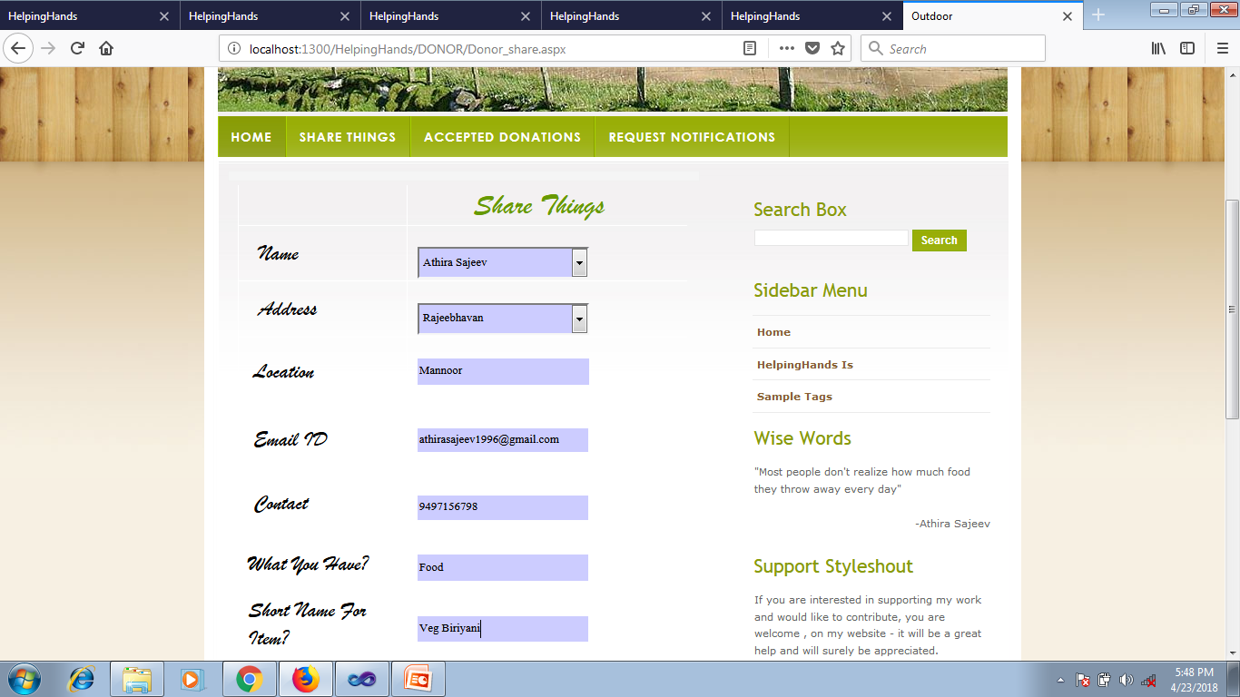

Slide 26
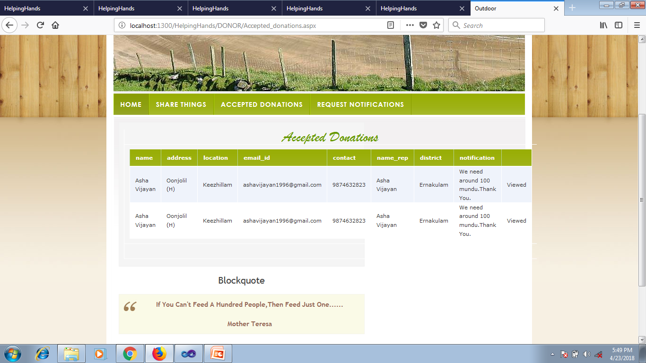

Slide 27
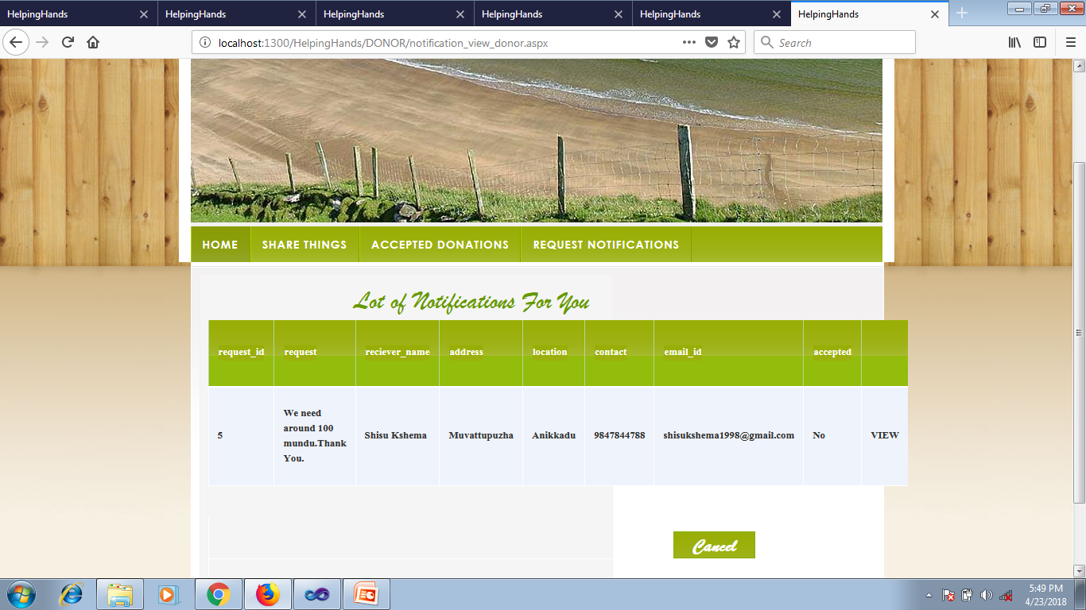

Slide 28
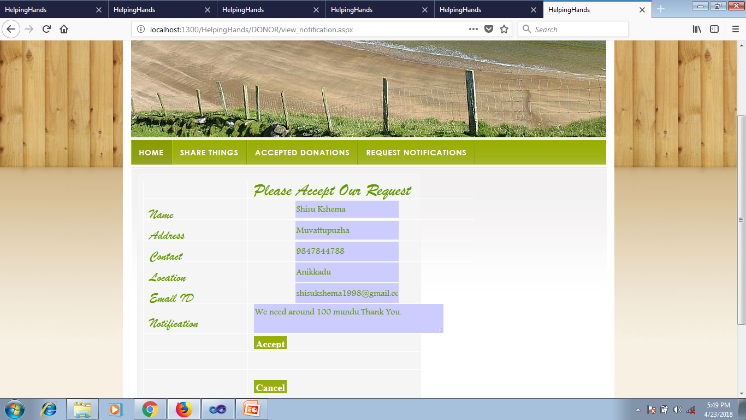

Slide 29
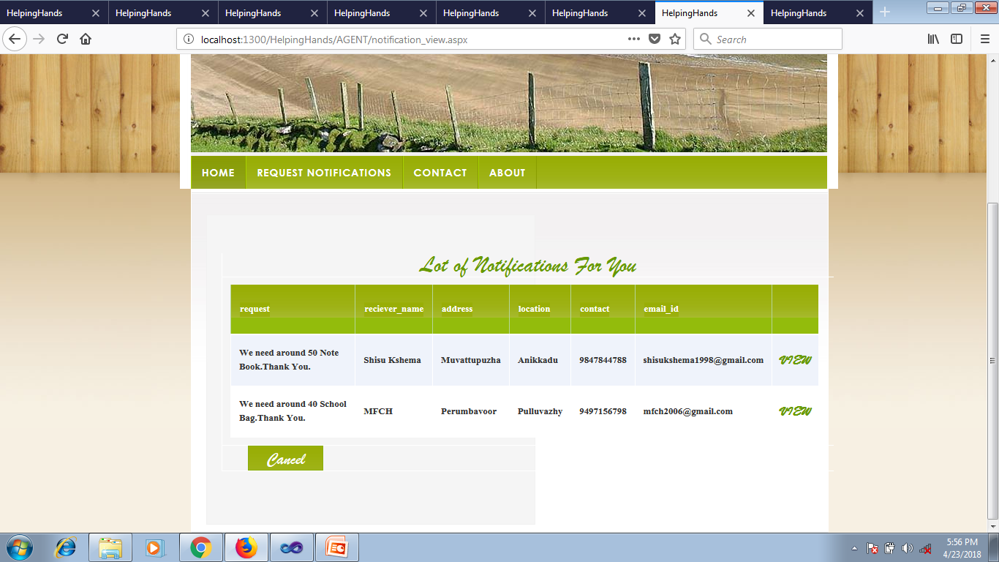

Slide 30
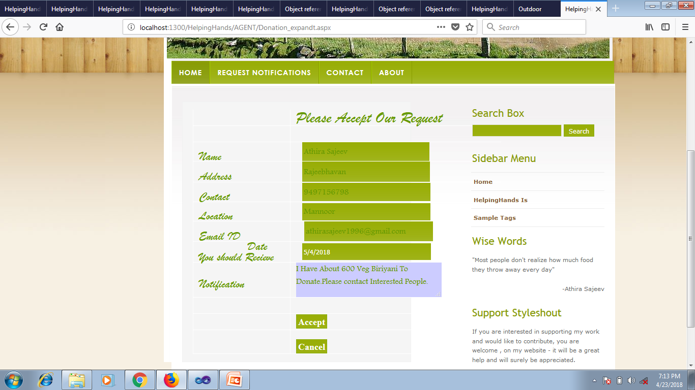

Slide 31
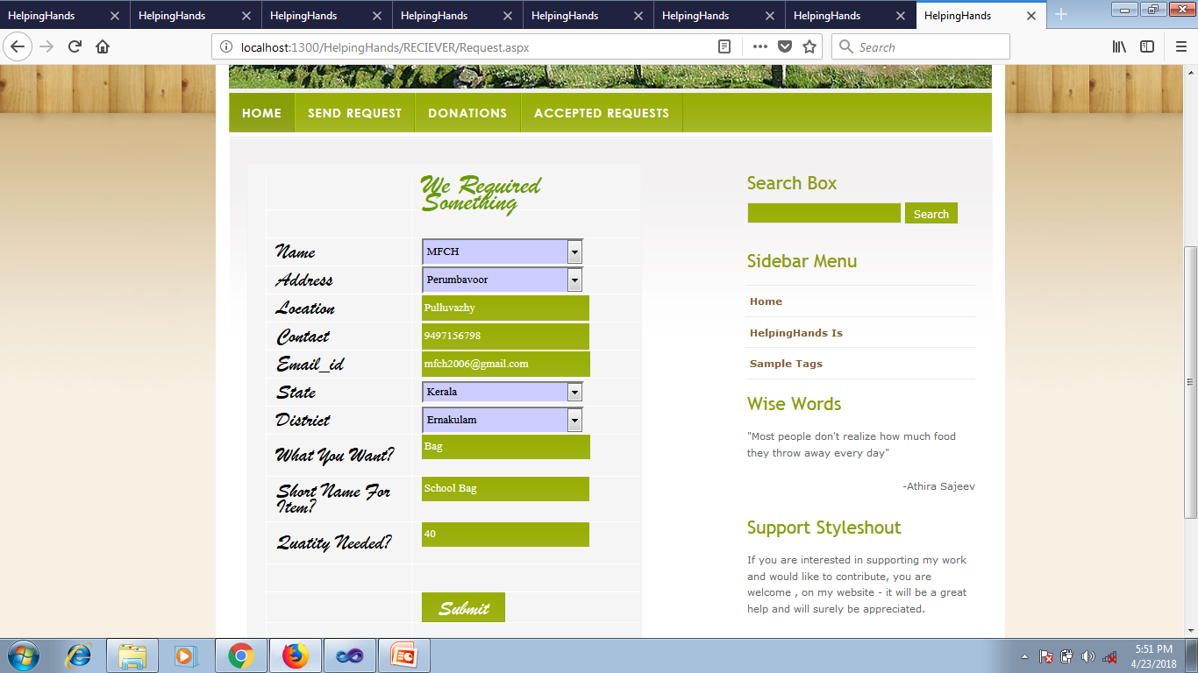

Slide 32
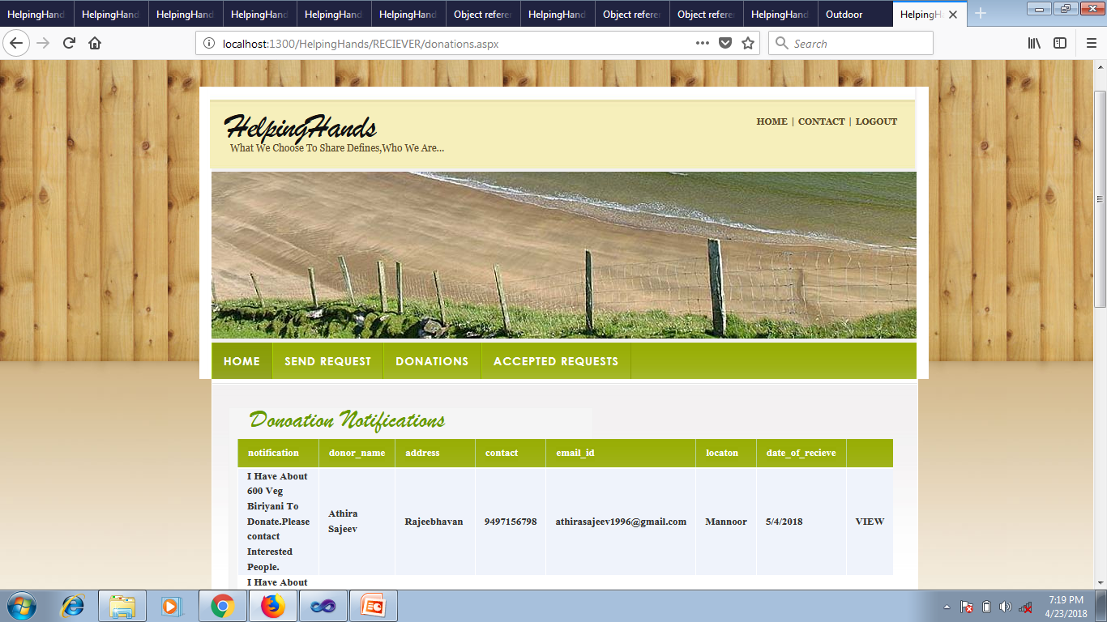

Slide 33
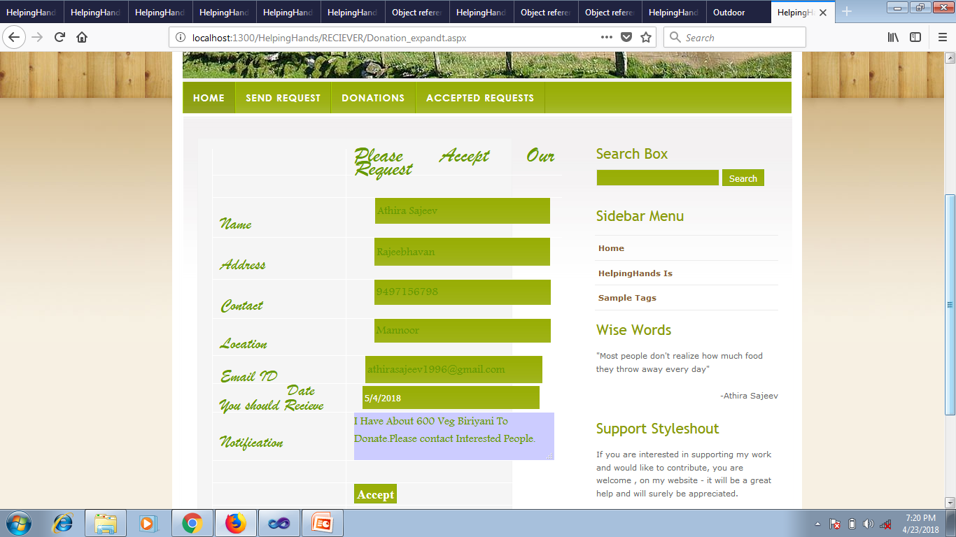

Slide 34
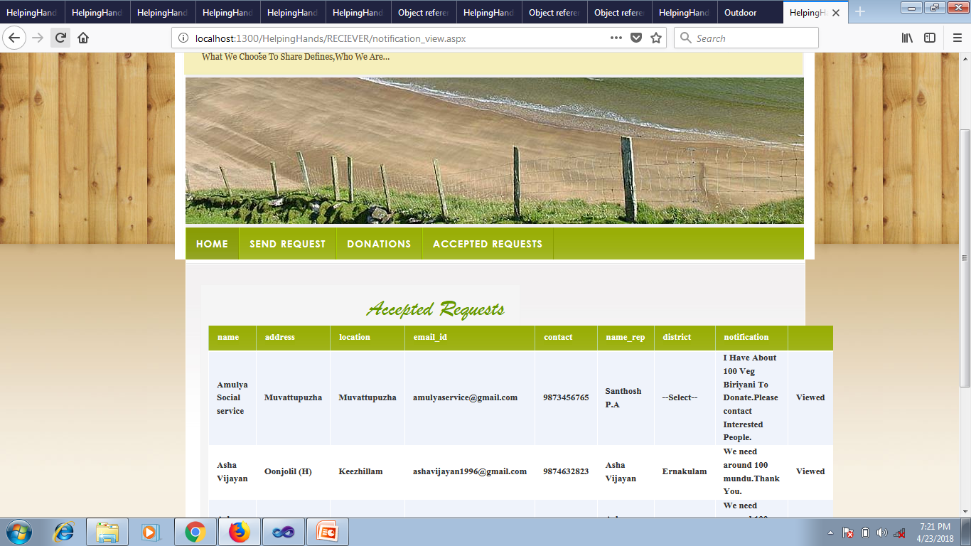

Slide 35
THANK YOU

